Slide 1
Qiskit Runtime
Tushar Mittal | Product Portfolio Lead, Quantum Services
Jessie Yu| Product Manager | Qiskit Runtime

Slide 2
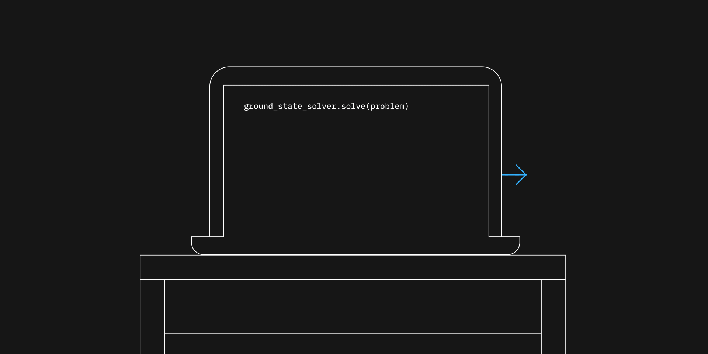
What is Qiskit runtime?
Qiskit Runtime is a quantum computing service and programming model that allows our users to optimize workloads and efficiently execute them on quantum systems at scale.

Slide 3

Basic structure of typical workloads
Classical
Quantum
Real workloads are not purely quantum, but rather require interaction between quantum and classical compute resources.

Slide 4




Classical-Quantum requirements vary based on workload and timescales
User programs
Middleware for Quantum
Qiskit Runtime
Dynamic circuits
User programs
Seconds to days
Elastic
100 milliseconds to hours
Near-time
Microseconds to seconds
Real-time
Nanoseconds to microseconds
Model developers Enterprises
Algorithm developers
Model developers
Kernel developers
Algorithm developers
Quantum researchers
Kernel developers

Slide 5
Qiskit Runtime: A programming model and execution framework to experiment at scale
Modular abstraction
Frictionless development
A series of primitive programs that enable a larger subset of our userbase to efficiently define workloads
Managed performance
Higher Quality Results
A framework to deliver managed services for error suppression and mitigation
Containerized execution
A containerized execution platform to maximize throughput of iterative workloads on time-share quantum systems
Faster Execution

Slide 6
Programming Model and Service
Modular abstraction
A series of primitive programs that enable a larger subset of our userbase to efficiently define workloads
Containerized execution
A containerized execution platform to maximize throughput of iterative workloads on time-share quantum systems

Slide 7
Evolving the programming model Introducing Primitives
backend.run(circuit)
Algorithm
Developer
Primitives 01 Estimator 02 Sampler
In computing, primitives are a collection of core functions available to a programmer. The primitives simplify use of quantum systems and allow for managed performance.
Kernel Developer
Backend.run()

Slide 8
Core primitives
The Estimator and Sampler encapsulate/abstract common queries seen in application packages.
Algorithm Developer
01 Estimator
02 Sampler
Input
Circuits + observables
Input
Circuit
Output
Expectation Values
Output
Quasi-probabilities
Use Cases:
electronic structure of a molecule
the cost function for an optimization problem
the kernel of a machine learning problem
Use Cases:
search algorithms
Notes:
Output
Quasi-probabilities

Slide 9
Getting started with Primitives
Primitives have been integrated across local and cloud development environment
Qiskit
Qiskit Aer
Statevector simulator
Aer Simulators
Local development
from qiskit.primitives import Estimator
from qiskit.primitives import Sampler
from qiskit_aer.primitives import Estimator
from qiskit_aer.primitives import Sampler
IBM Quantum Platform &
IBM Cloud
IBM Runtime Provider
IBM Quantum systems or cloud simulators
from qiskit_ibm_runtime.primitives import Estimator
from qiskit_ibm_runtime.primitives import Sampler

Slide 10
Running on Quantum Hardware with Qiskit Runtime

Slide 11
Execution Options Today
Backend.run Model
Upload Runtime Programs
Runtime Primitives
User Machine
IBM Quantum Systems
IBM Qiskit Runtime Infrastructure
IBM Quantum Systems
User Machine
IBM Quantum Systems
User Machine
IBM Qiskit Runtime Infrastructure
User Program
User managed Environment
(cloud/on-prem)
IBM Quantum Datacenter
Quantum Subroutine

Slide 12
Evaluating the approaches
Backend.run Model
Upload Runtime Programs
Runtime Primitives
IBM Quantum Systems
IBM Qiskit Runtime Infrastructure
IBM Quantum Systems
User Machine
IBM Quantum Systems
User Machine
User Machine
IBM Qiskit Runtime Infrastructure
Classical Elasticity
Queuing latency
Near -time Caching
Error mitigation services
Enabling SaaS

Slide 13
backend.run
Backend.run Model
Upload Runtime Programs
Runtime Primitives
User Machine
IBM Quantum Systems
IBM Qiskit Runtime Infrastructure
IBM Quantum Systems
User Machine
IBM Quantum Systems
User Machine
IBM Qiskit Runtime Infrastructure
Classical Elasticity
Queuing latency
Near -time Caching
Error mitigation services
Enabling SaaS

Slide 14
Uploading programs
Backend.run Model
Upload Runtime Programs
Runtime Primitives
IBM Quantum Systems
IBM Qiskit Runtime Infrastructure
IBM Quantum Systems
User Machine
IBM Quantum Systems
User Machine
User Machine
IBM Qiskit Runtime Infrastructure
Classical Elasticity
Queuing latency
Near -time Caching
Error mitigation services
Enabling SaaS

Slide 15
Introducing Sessions
A contract between your remote, iterative program and Qiskit Runtime service that allows you to manage context aware workloads.
Manage scheduling priority of jobs that are batched or iteratively called
Maintain cache of data transferred during the session for reuse (transpilation of parametric circuits, mitigation models)
Flexibility to integrate with non-IBM compute or cloud service remotely
Runtime Primitives
User Machine
IBM Qiskit Runtime Infrastructure
IBM Quantum Systems

Slide 16
Runtime Primitives
Backend.run Model
Upload Runtime Programs
Runtime Primitives
IBM Quantum Systems
IBM Qiskit Runtime Infrastructure
IBM Quantum Systems
User Machine
IBM Quantum Systems
User Machine
User Machine
IBM Qiskit Runtime Infrastructure
Classical Elasticity
Queuing latency
Near -time Caching
Error mitigation services
Enabling SaaS

Slide 17
Benchmarking Performance today

Slide 18
How do primitives enable Error Mitigation
Backend.run Model
Upload Runtime Programs
Runtime Primitives
IBM Quantum Systems
IBM Qiskit Runtime Infrastructure
IBM Quantum Systems
User Machine
IBM Quantum Systems
User Machine
User Machine
IBM Qiskit Runtime Infrastructure
Classical Elasticity
Queuing latency
Near -time Caching
Error mitigation services
Enabling SaaS

Slide 19
Extending Primitives with Managed Performance
Algorithm Developer
Primitive enable task-specific mitigation capabilities
01 Estimator
02 Sampler
Input
Circuits + observables
Output
Expectation values
Input
Circuit
Output
Quasi-probabilities
Explore tradeoffs between, cost, accuracy, time by leveraging the latest research in error mitigation and suppression
Managed Performance Capabilities
Error Suppression: Dynamical Decoupling
Error Mitigation: Measurement Mitigation, Probabilistic Error Cancellation, Zero Noise Extrapolation
Error Suppression: Dynamical Decoupling
Error Mitigation: Measurement Mitigation

Slide 20
Now, lets see how you can take advantage of these capabilities
Modular abstraction
Frictionless development
A series of primitive programs that enable a larger subset of our userbase to efficiently define workloads
Managed performance
Higher Quality Results
A framework to deliver managed services for error suppression and mitigation
Containerized execution
A containerized execution platform to maximize throughput of iterative workloads on time-share quantum systems
Faster Execution

